Slide 1
American 1 Credit Union
Media Strategy + Buying

Slide 2

On behalf of the entire team at ddm marketing + communications, thank you for the opportunity to share how we can partner with American 1 Credit Union on your digital advertising campaigns.
We hope the following presentation provides clarity to our approach to media strategy and buying. We are always available to answer any follow-up questions or share additional insight.

Slide 3
Agency overview

Slide 4





Who we are
      FOUNDED IN
      HEADQUARTERED IN WEST Michigan
      employees
      1990
      Grand Rapids
      50⁺
      Full-service agency working with
      highly regulated industries
      We offer a full array of communication, marketing, and technology services to businesses in highly complex and highly regulated industries.
      We serve a diverse national and international client base, ranging from healthcare and financial services to medical device and global manufacturing.
      Healthcare
      financial
      manufacturing
Notes:
60 team members
ddm builds strategic partnerships with clients that lead to long-term relationships
National and international client base

Slide 5

OUR TEAM
Our team is composed of 50+ experts in various marketing disciplines. We have in-house teams specializing in design and content, media (digital and traditional), interactive development, and marketing automation. All are supported by a robust account services team, ensuring strategic direction and project leadership.

Slide 6


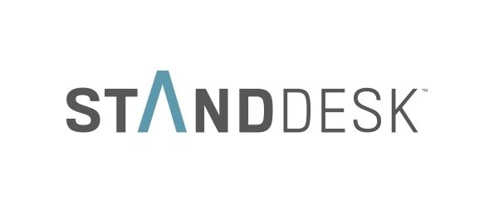

Notable
CLIENTS

Slide 7
our approach

Slide 8
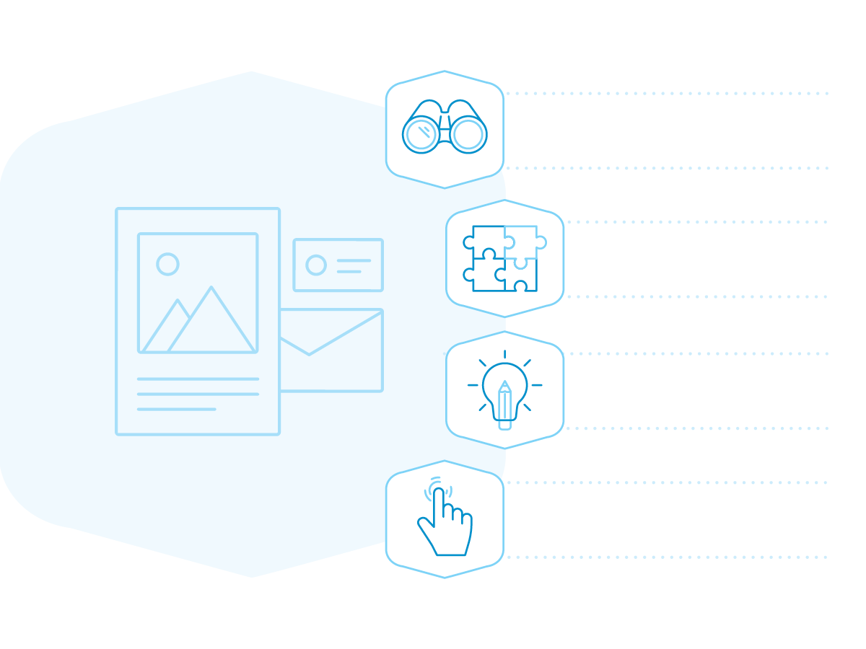
approach
Our approach is collaborative… seriously. Nobody knows your customers better than you. We’re the ones who know how to reach them. So together, we’ll develop a plan to engage your audience, create compelling communications, and put those things into action. We begin by thinking broadly about your challenges and opportunities. Then, we’ll consider your marketing landscape holistically before zeroing in on targeted solutions. This is a multi-step process designed to establish alignment and confidence at every step.
Discovery
  Listen
  Understand
  Goals + targets + audience
Strategy
  Research
  Align to business strategy
  Messaging + CTA
Create
  Design
  Present
  Advise
  Implement
Activate
  Deliver
  Reiterate

Slide 9

MEDIA BUYING
At ddm, we typically spend between $4–5 million in media annually. Approximately 70% is digital media and 30% traditional. This breakdown varies for each client based on their target audience and campaign goals.
We believe that a media buy should always be ONLY in the best interest of our client, and that’s why we use a transparent RFP process for every media buy we make. The industry standard commission for media is 20% on digital and 15% for traditional. However, the media market has a shady reputation for agency kickbacks that give the appearance of a discounted commission.
By using a transparent RFP process, ddm ensures the best pricing on the highest quality media assets for our clients. Also, we don’t use pre-negotiated rates because the media market fluctuates wildly over the course of a year. Those rates that were locked-in six months ago at what seemed like a good buy are now overpriced in the market. The RFP ensures we’re getting the most current best prices.

Slide 10
MEDIA STRATEGY

Slide 11

MEDIA STRATEGY
The media landscape continues to change. How your target audiences consume and share information has changed as well. The obvious goals are to be where they are and successfully engage with them. That’s why it’s more important than ever to take an integrated approach to marketing with a mix of digital and offline methods. Our media team helps you reach the right people at the right time with…
• a contemporary understanding of today’s media landscape.
• a robust process for discovery, research, and strategy.
• insightful media strategy that integrates content creation.
• hard-working placement supported by nimble optimization.

Slide 12

DISCOVERY
Discovery provides us with the opportunity to listen and learn key information that influences your campaign strategy:
• Targets: develop an understanding of our target audience, what motivates them, and how best to reach them.
• Goals: define campaign objectives and KPIs.
• Key messages: articulate messages that will resonate with your audience.
• Budget: set allocation expectations in relation to campaign goals to ensure maximum effectiveness for your budget.

Slide 13

RESEARCH
Research creates the insights that inform our strategy and planning:
• We’ll use media consumption data to identify where your audience is consuming media.
• And leverage digital tools to glean audience capacity, performance opportunities and expectations.

Slide 14
DELIVERABLES
Effective media strategy considers all available channels to achieve the campaign goals. Our thinking goes into how to maximize the budget for the biggest impact. That is, when, how, and where the campaign runs. We distill our insights and planning into the following documents:
MEDIA BRIEF
MEDIA FLOWCHART
A comprehensive media brief will communicate the optimal way to achieve media objectives, creative considerations, media channels, key considerations, budget allocation, and define campaign KPIs.
A detailed media flowchart has details of all media buys, making it possible to develop synergy across multiple marketing platforms.
Our hard-working implementation is nimble, focused on placement strategies and content optimization.
Starting from the initial media placement and every day forward, we carefully monitor and manage every detail of your media campaign to improve performance.

Slide 15
REPORTING + OPTIMIZATION

Slide 16
REPORTING + OPTIMIZATION
We believe one of our differentiators is the ability to understand and interpret data and make actionable changes to improve campaign performance.
• Implementation
• Management
• Reporting
• Optimization
We utilize Google Data Studio to provide our media clients with a real time reporting dashboard that allows them access to view campaign performance at their convenience. We also have set check-ins to review the data with the client on a weekly, monthly, or quarterly basis to provide a detailed analysis and recommendations.
Example of a Google Data Studio dashboard

Slide 17

BUDGET VS. EXPECTED OUTCOMES
Expected outcomes will be communicated when we finalize our discovery + strategy phase. American 1 Credit Union will receive a comprehensive media brief that will communicate:
• The optimal way to achieve your media objectives
• Creative considerations
• Media channels
• Key considerations
• Budget allocation
• Campaign KPIs
Our objective is to align with American 1 Credit Union’s goals as we move into the execution phase.

Slide 18
Case Studies

Slide 19

Great American Spaces
As a new product for Lumbermen’s, the challenge was to create brand and product awareness, and generate qualified leads for its dealer network that spanned across multiple states. ddm created and executed a digital media campaign geographically focused on each dealer location. See our results in the full case study. (Appendix, pages 1-10)

Slide 20
Metro Health – University of Michigan Health
Always respected, but the perception as an advanced health service provider trailed other systems in the market. An affiliation with Michigan Medicine provided an opportunity to adjust its positioning and adjust perceptions in the marketplace. See the omni chancel campaign ddm developed and executed to achieve Metro Health’s goals in the full case study. (Appendix, pages 11-15)

Slide 21
Additional Information
Over the last two years, ddm has undergone a cultural and organizational transformation through the Entrepreneurial Operating System (EOS).​ With it, our team has benefited from departmental idea sharing, cross-team reviews, and a greater sense of structure and purpose. The following slides highlight ddm today.

Slide 22






Our
Core Values
Our core values contribute to the soul of who we are on our best days. These are our guiding principles and serve as the definition of who we are as individuals within ddm as well as how we perpetuate values to our clients, our team, and our partners.
Serve our clients
tenaciously
Be curious—first ask why,
then tackle how
Deliver excellence,
not excuses
  We serve our clients tenaciously with a constant drive to fulfill their goals and build a strong relationship.
  We approach each task by first asking ‘why’ to gain the understanding that allows us to problem-solve and perhaps uncover an unseen opportunity for our clients.
  Our team’s follow-through allows us to deliver excellence, not excuses, but we hold ourselves personally accountable for our own successes and failures.
Respect
the team
Run through
the wall attitude
Play up
a level
  Each of us brings unique skills to the table, but we work as a cohesive team that respects each other and our clients.
  We’re known for our responsiveness but beneath that is an enthusiasm and determination to accomplish goals—even if they go beyond ‘normal’ expectations.
  We routinely play up a level by accepting roles and responsibilities that cause us to grow and increase in value.

Slide 23
Our capabilities
  As an integrated marketing, communications, and technology partner, we leverage a collection of skills and mediums to activate connections between our clients and their target audiences to meet specific business goals. The following categories represent how ddm shares our range of broader skills and capabilities.
MARKETING +
COMMUNICATIONS STRATEGY
CONTENT +
COMMUNICATIONS
BRAND +
DESIGN
  Great execution grows from a strategic foundation to create powerful results that link your organization’s future to the present. We’ll help you develop a strategy that reflects a clear understanding of your target audience, defines a unique and compelling position, and identifies a mix of marketing efforts that best tells your story and influences measurable results.
  You have a story to tell. We’ll help you find your voice and create compelling content in an ever-evolving communications environment to effectively engage audiences through stories, articles, video creation, and social content. And we’ll help you span across paid, earned, and owned media as well as internal communications.
  Brand and design are inextricably linked. Design feeds your brand while your brand reflects the purpose and emotion of your organization. We’re as equally skilled in creating a brand experience as we are in implementing your brand into practical applications that support your business operations, including advertising, marketing collateral, event graphics, and presentations.
MEDIA PLANNING +
BUYING
WEB +
APPS
EMAIL +
MARKETING AUTOMATION
  The goal of media planning and buying is to identify and place your content in front of your ideal audiences at the right time, place, and context for them to be seen and acted upon. We use our expertise to coordinate traditional and digital media, including Google ads, paid social media, television, radio/streaming audio, OTT, outdoor, and print.
  With a robust team of in-house developers, we help plan, architect, design, and build digital solutions that balance your organization’s goals with user needs and technology opportunities. The results can vary from dynamic customer-focused websites to sales-enabling web applications that integrate with third-party data sources.
  We know how to leverage the power of systems to streamline sales and marketing efforts. While there are a lot of tools that help mechanize the process, our team of experts is ready to use their intelligence and experience to plan, coordinate, manage, develop, and measure efforts for timely and responsive digital communications and automated publications.

Slide 24
The ddm way
OUR APPROACH
  With a commitment to effectiveness, we’ve found the best approach to helping our clients combines impactful strategies with dynamic solutions and proven execution. This holistic approach effectively solves marketing and communications challenges and delivers targeted and strategic outcomes.

Slide 25
Thank you.
John Williamson
    Account Leader
      johnw@teamddm.com
      C 616 570 8309

